Slide 1
System Calls and Programming
Module 2
ITSC205
Operating Systems Internals

Slide 2
System calls and Programming
C-code components
Compilers and Interpreters
Pointers
System Calls
Types of System Calls
Operating System Debugging
How the shell works

Slide 3
C programming Language
C programming Language is a structured , procedural language, it was developed in 1972 by Dennis Ritchie at Bell Labs and in 1978 Kernighan & Ritchie published the first edition C programming language book.
In 1972 large part of Unix operating system was rewritten in C language
ANSI C was completed in 1988

Slide 4
C Program Components
1. Header files are required by C library functions such as printf
#include <header_file.h>
e.g. In Linux the command man 3 printf will provide the header file
required by rintf( ) function
2. #define constants
3. Declare Global variables outside the main( ) function
4. main ( ) is the default function of C programming.
main ( ) {
declare local variables for this function
C library functions
call user-defined functions
}
5. Declare user-defined functions { declare local variables}

Slide 5
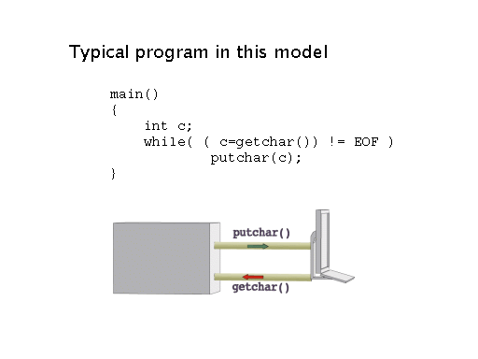

Slide 6
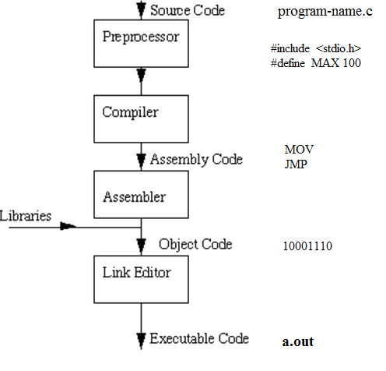
Compilers – Compilation process
https://www.youtube.com/watch?v=VDslRumKvRA

Slide 7
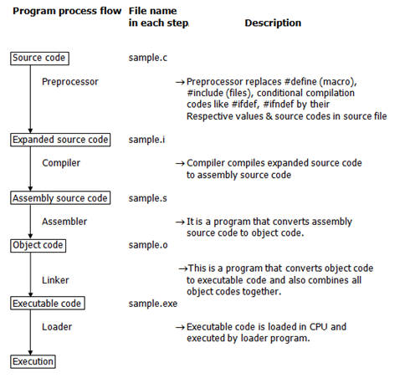
Compiler
http://users.cs.cf.ac.uk/Dave.Marshall/C/

Slide 8
Compilers
Pre-processor also known as cpp (check linux man cpp)or macro processor that transform source code before compilation.
Pre-processor output: gcc -E program.c
https://gcc.gnu.org/onlinedocs/cpp/Preprocessor-Output.html
Assembly code. You can use objdump with –D option to display assembler code of machine instructions. e.g.
gcc -g -c program.c It will generate an .o file
objdump -d -S program.o It will displays assembly code
3. Link to libraries needed by the program and not explicit in the C code
e.g. gcc program.c -lm It will link to math library
Executable code
gcc program.c It will generate executable a.out

Slide 9
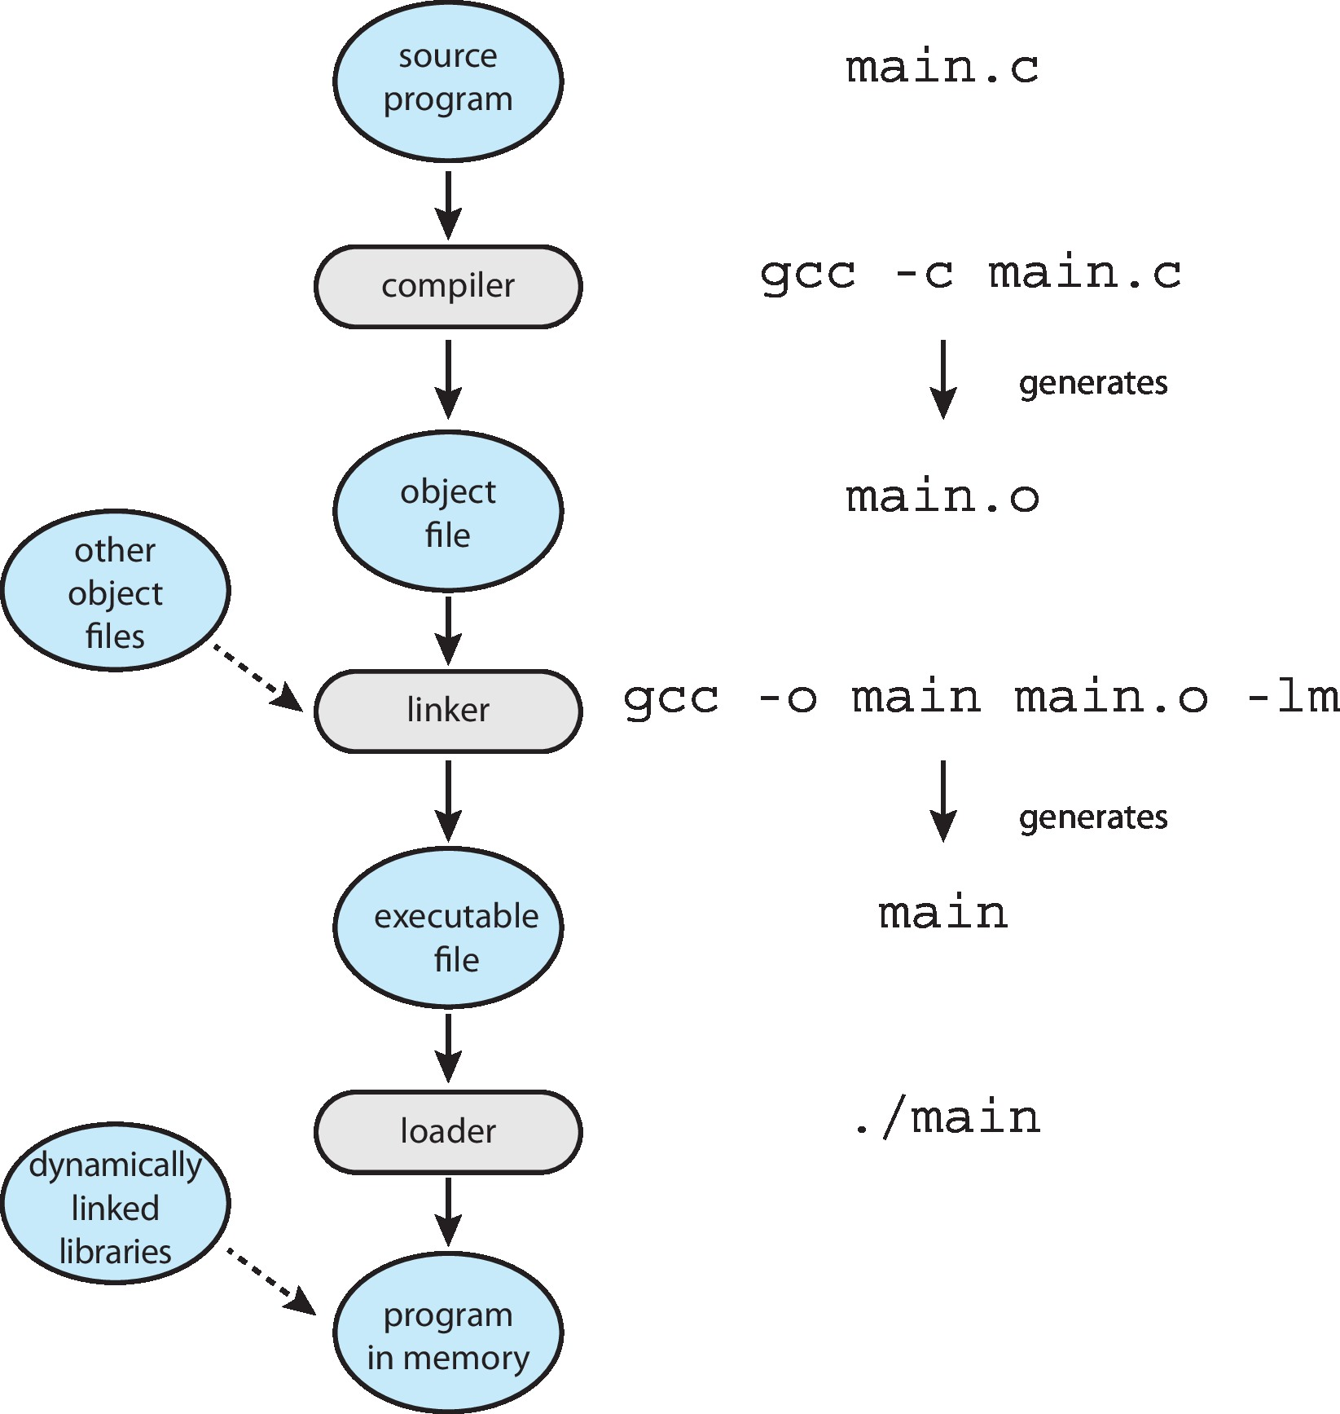
Linker and Loader

Slide 10
Linker and Loader
Linker combines these into single binary executable file
Program resides on secondary storage as binary executable
Must be brought into memory by loader to be executed
Relocation assigns final addresses to program parts and adjusts code and data in program to match those addresses
Modern operating systems, dynamically linked libraries (in Windows, DLLs) are loaded as needed, shared by all that use the same version of that same library (loaded once)

Slide 11
Standard Libraries
Shared libraries are collections of routines needed by a program to work.
There are number of standard libraries used by more than one process at the same time.
Dynamically linked libraries (DLL) (Windows Module) are only loaded when a process is run,
Libraries in Unix system are called libc. Shared libraries in Linux have extension .so in Windows .dll (DLL)

Slide 12
Modules
Most modern operating systems implement loadable kernel modules
Main routines (modules) can be built directly into the kernel and other modules can be loaded dynamically while the kernel is running
Each module is loadable as needed within the kernel
It uses object-oriented approach
Each core module is separated
Each module talks to the others over known interfaces
Linux implements loadable kernel modules for drivers and file systems
Linux commands to manage modules:
lsmod --- displays current loaded kernel modules
insmod --inserts a module into the kernel
rmmod – remove module from kernel

Slide 13
Object and Executable Files
Object and Executable files have standard formats that includes compiled machine code and functions metadata, so operating system knows how to load and start them.
For UNIX standard format is ELF ( Executable and Linkable Format). ELF file contains address of first instruction to be executed when program runs
For Windows standard format is PE (Portable Executable)

Slide 14
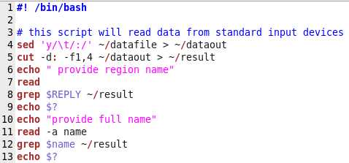
Interpreters
Interpreter interprets commands or instructions line by line such as shells. e.g. the following script will be interpreted by bash shell.

Slide 15
Pointers
A pointer is a variable that contains the memory address of another variable. We can have a pointer to any variable type.
& provides the memory address of a variable.
The dereference operator * refer to the content of variable pointed by a pointer.
Declare a pointer to a variable: int *pointer;
We must associate a pointer to a particular type. A pointer is declared an integer type because we can increment or decrement the pointer by integer values e.g ++ *pointer, but the content of a pointer is not an integer, it is a memory address type.
Consider the effect of the following code:
int x = 1, y = 2, *ip;
ip = &x;
y = *ip;
*ip = 3;

Slide 16
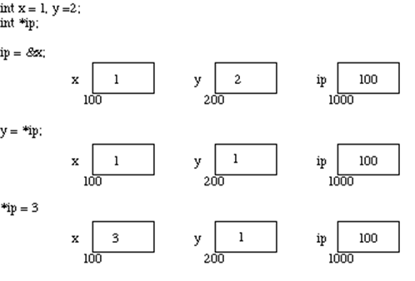
Pointers

Slide 17
System Calls
System calls are routines written in a high-level language (C and C++)
System calls provide an interface to the services provided by the OS kernel. Systems execute often thousands of system calls.
e.g The user executes printf( ) function which invokes write() system call to perform the output
API specifies a set of functions including parameters that are available to an application programmer. Application developers mostly design programs based on an Application Program Interface (API). APIs invokes system calls.
e.g. in Windows CreateProcess invokes NT
Three most common APIs are Win32 API for Windows, POSIX API for POSIX-based systems (including virtually all versions of UNIX, Linux, and Mac OS X), and Java API for the Java virtual machine (JVM)

Slide 18
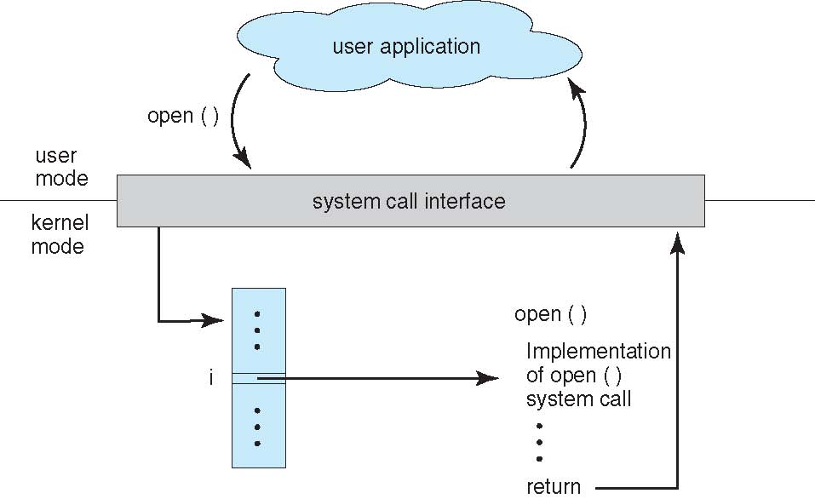
API – System Call – OS Relationship
ITSC 205 Operating Systems Internals

Slide 19
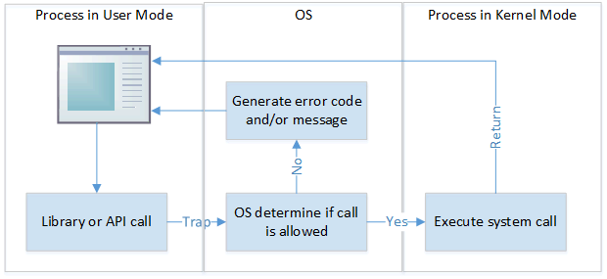
System Calls

Slide 20
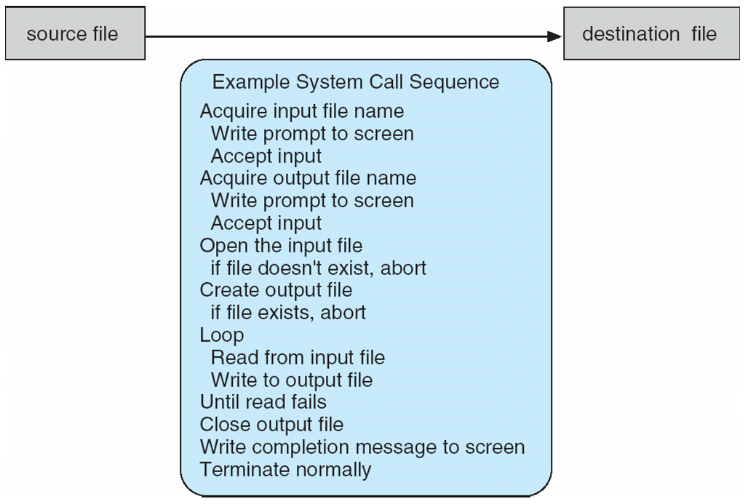
Example of System Calls
System call sequence to copy the contents of one file to another file

Slide 21
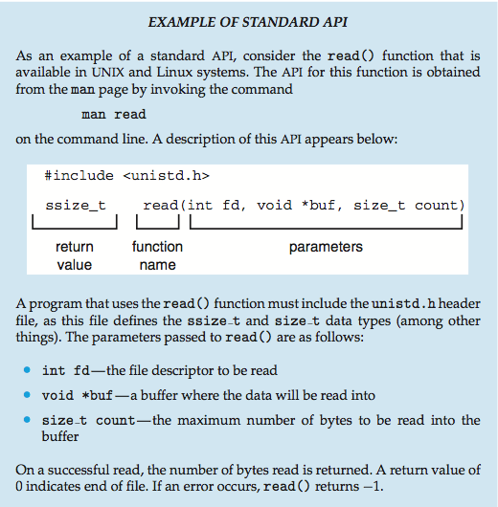
Example of Standard API

Slide 22
System Call Implementation
Every system call is associated with a number and the System-call interface maintains a table indexed according to these numbers
The system call interface invokes intended system call in OS kernel and returns status of the system call and any return values
Most details of OS interface are hidden from the programmer by API and managed by run-time support library (set of functions built into libraries included with a compiler)

Slide 23
System Call Implementation
Often, more information is required than simply identity of desired system call. Exact type and amount of information vary according to OS and call.
e.g to “get an input” a file or device is needed as a source as well as the address and length of memory buffer where the input should be read is required.

Slide 24
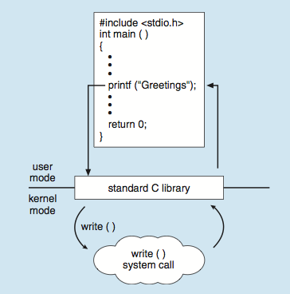
Standard C Library Example
C program invoking printf() library call, which calls write() system call

Slide 25
System Call Parameter Passing
Three general methods used to pass parameters to the OS
1. Simplest: pass the parameters in registers
In some cases, there are more parameters than registers
2. Parameters stored in a block, or table, in memory, and address of block passed as a parameter in a register
This approach is taken by Linux and Solaris
3. Parameters placed, or pushed, onto the stack by the program and popped off the stack by the operating system
Block and stack methods do not limit the number or length of parameters being passed

Slide 26
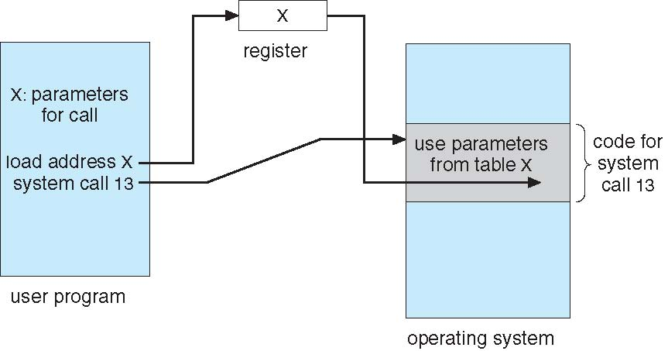
Parameter Passing via Table
ITSC 205 Operating Systems Internals

Slide 27
Types of System Calls
System call number mapping table are defined in file header:
/usr/src/linux-headers-2.6/include/asm-generic/unistd.h
Process control
end, abort
load, execute
create process, terminate process
get process attributes, set process attributes
wait for time
wait event, signal event
allocate and free memory

Slide 28
Types of System Calls
File management
create file, delete file
open, close file
read, write, reposition
get and set file attributes
Device management
request device, release device
read, write, reposition
get device attributes, set device attributes
logically attach or detach devices
System calls from kernel.org documentation:
https://www.kernel.org/doc/man-pages/

Slide 29
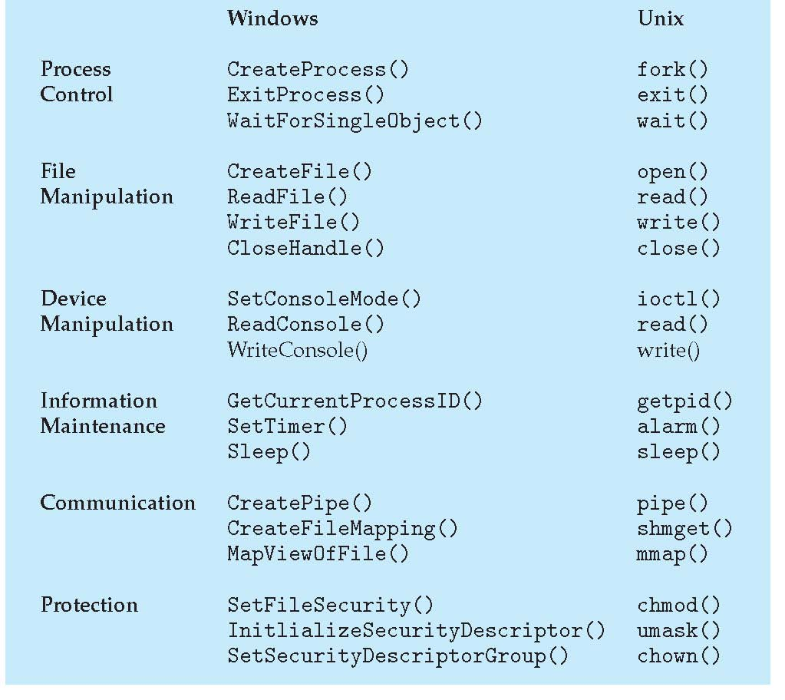
Examples of Windows and Unix System Calls

Slide 30
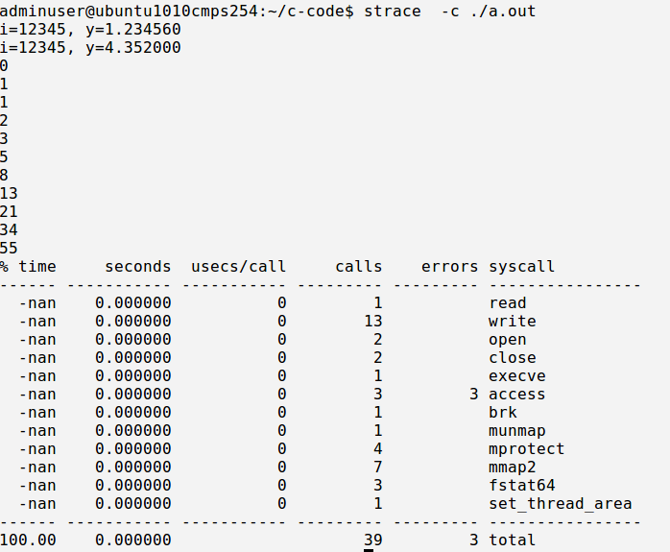
Strace and System calls

Slide 31
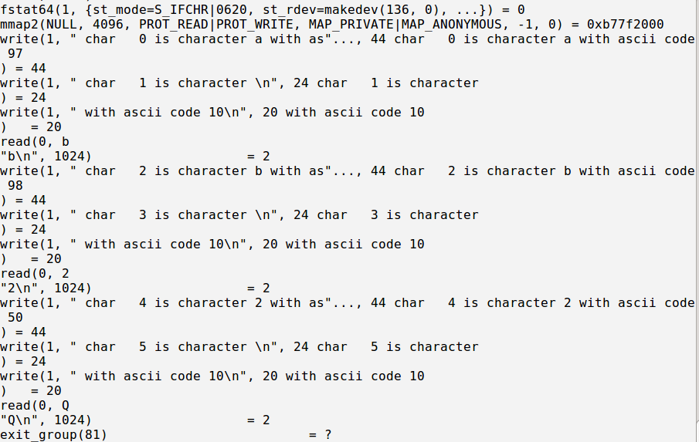
Strace and System Calls

Slide 32
How does the Shell work ?
The shell is a program that interprets commands.
The shell performs the following:
1. The shell reads input from STDIN
2. It parses the line(input) into tokens to get the command and arguments
3. The shell (parent process) creates (clones ) a new process by calling
fork( ) system call to replicate itself (a child process).
4. The program (command) is loaded into the new process (child
process) and the arguments argv[] are passed to the program
5. The child process executes the program by invoking exec( ) system
call to execute the program (command ) with the respective arguments.
6. The parent process waits (wait() system call) for child process status

Slide 33
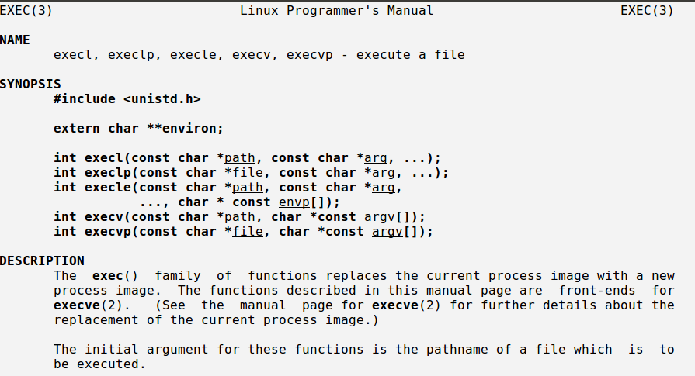
Linux man exec( ) System Call

Slide 34
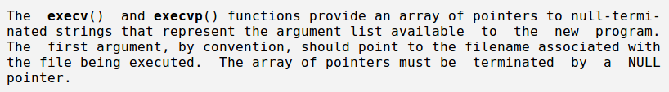
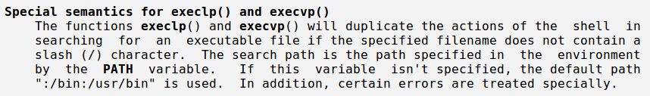
execvp( ) System Call

Slide 35
execvp( ) System Call
Execvp() executes a program with path searching
#include <unistd.h>
execvp( const char *file, const char *argv[])
*file pointer to the file(program to execute)
*argv[] array of strings
Example
execvp( arglist[0], arglist )
execvp( “ls” , arglist )

Slide 36
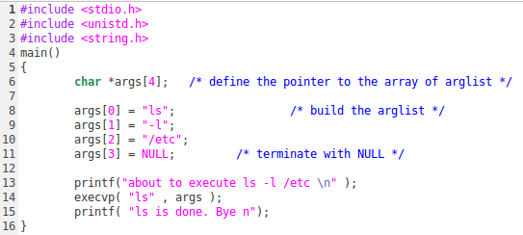
Shell Programming

Slide 37
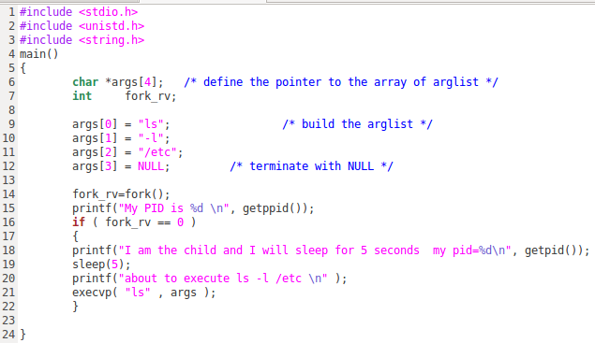
Shell Programming

Slide 38
System Programs
System programs provide a convenient environment for program development and execution. Some of them are simply user interfaces to system calls; others are considerably more complex. They can be divided into:
File manipulation
Status information sometimes stored in a File modification
Programming language support
Program loading and execution
Communications
Background services
Application programs
Most users’ view of the operation system is defined by system programs, not the actual system calls

Slide 39
Operating-System Debugging
Debugging is finding and fixing errors, or bugs
OSes generate log files containing error information
Failure of an application can generate core dump file capturing memory of the process
Operating system failure can generate crash dump file containing kernel memory
gdb debugger http://man7.org/linux/man-pages/man1/gdb.1.html

Slide 40
Linux Kernel and System calls
https://www.kernel.org/doc/html/latest/process/adding-syscalls.html

Slide 41
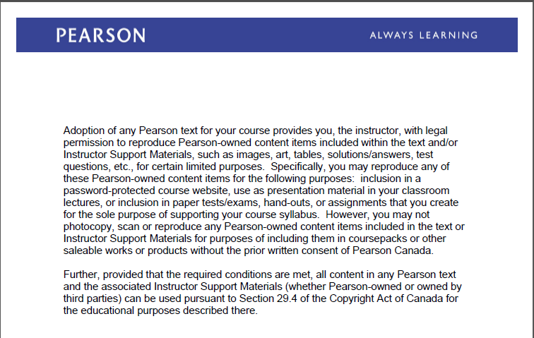
Text Book Slides – Copy Right

